Slide 1
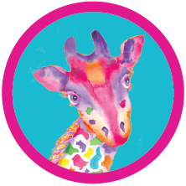
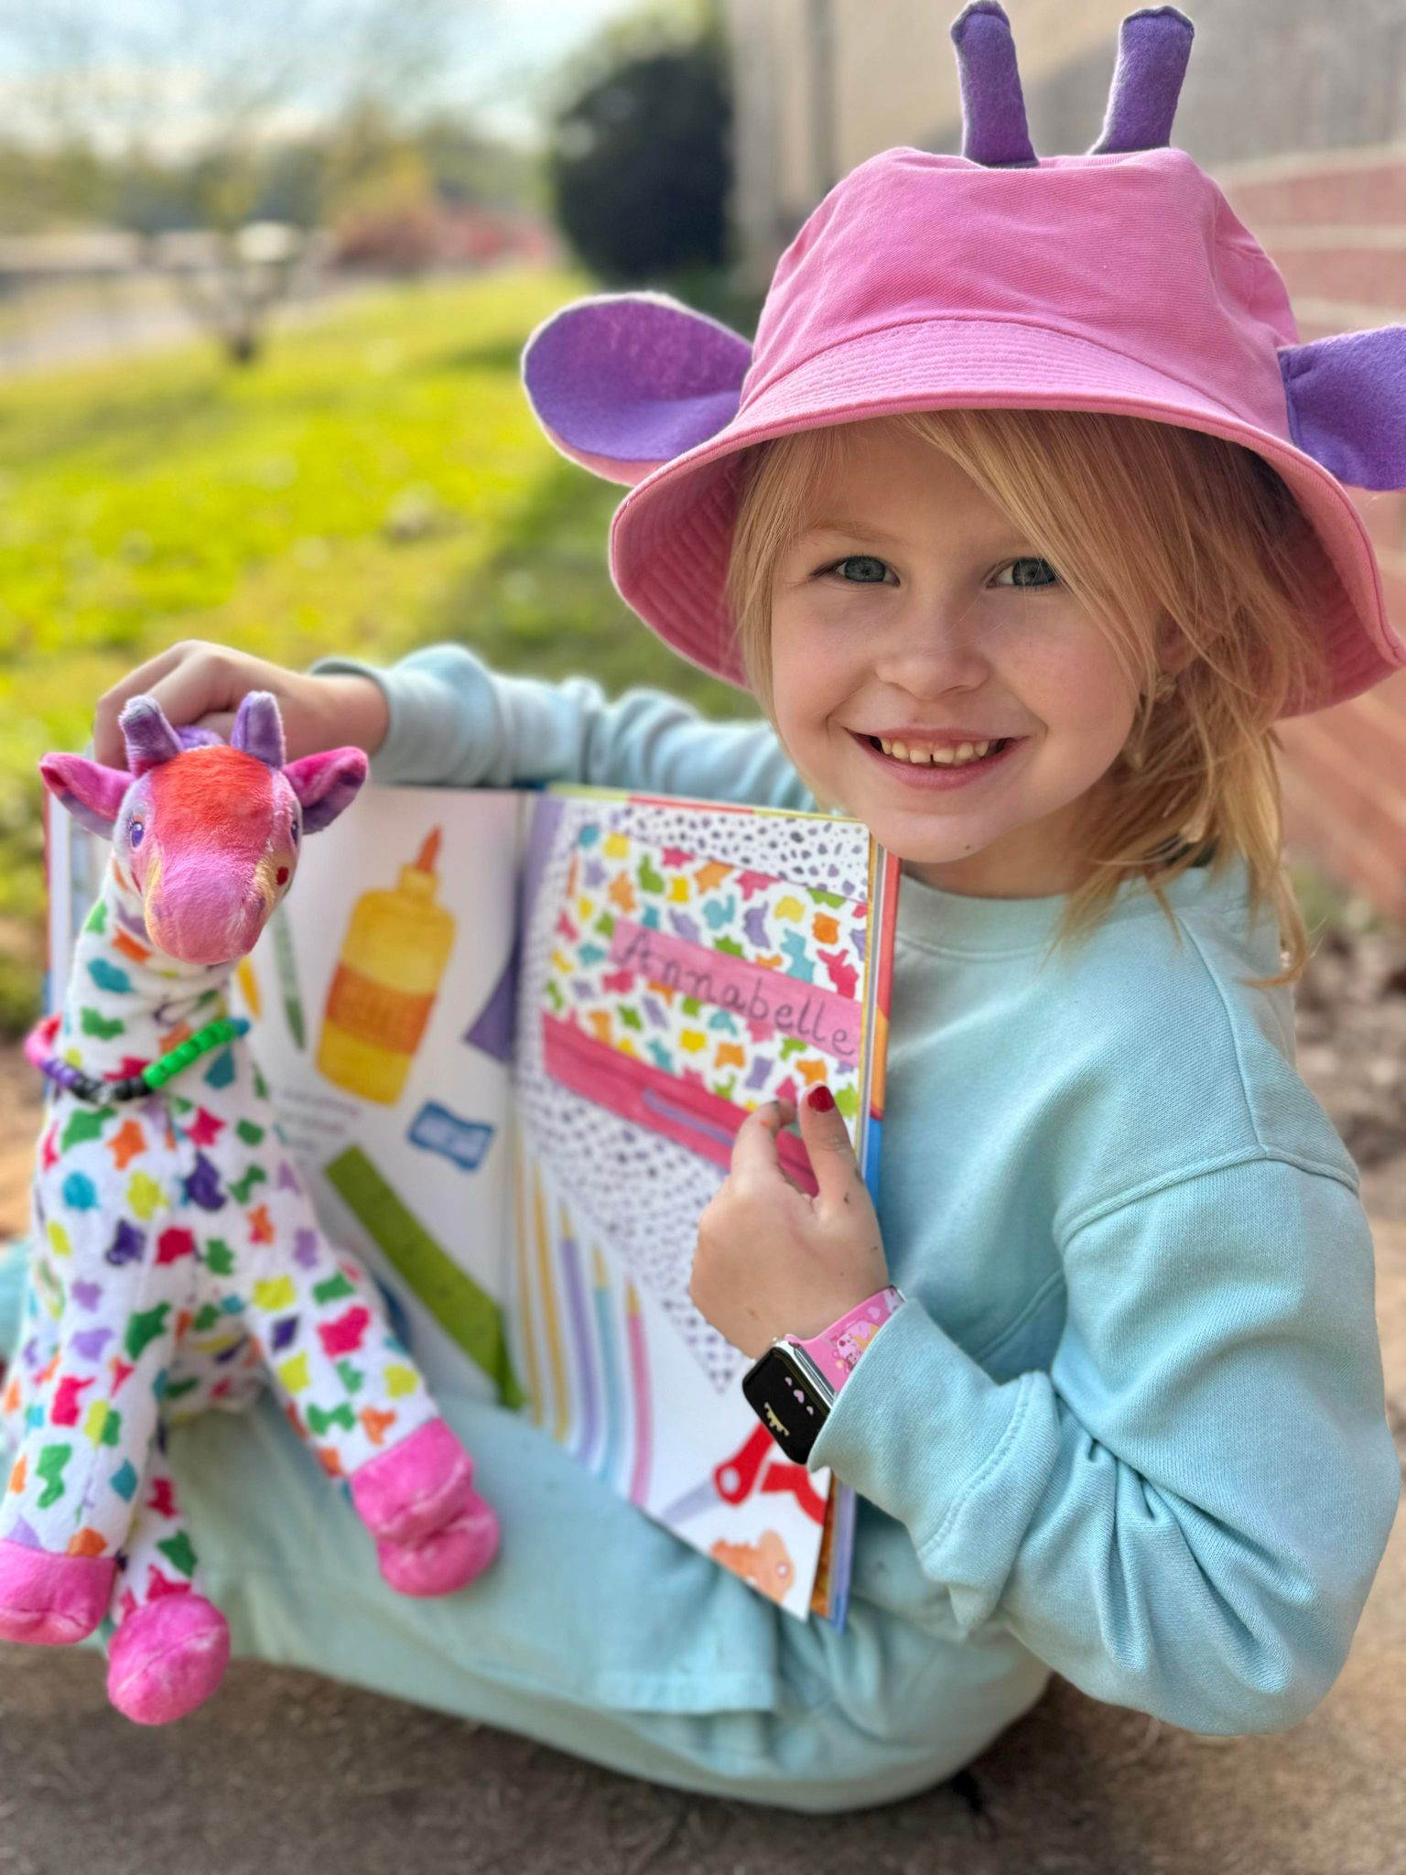
Using Early Learning Standards and Formative Assessments to Guide Instruction
Jenny Hunter

Slide 2
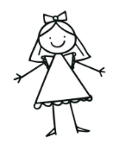
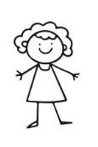
Formative Assessment Workshop
How to involve parents and create transitional activities in the classroom to support student learning
using informal formative assessment strategies and learning goals.
Teacher
Parents

Slide 3
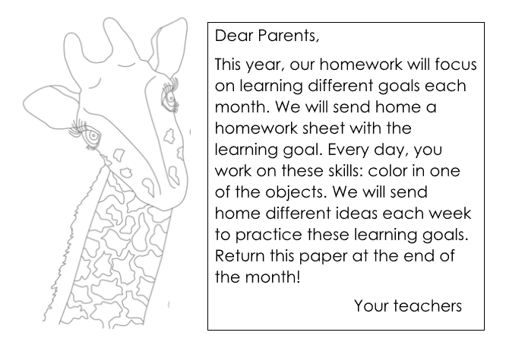
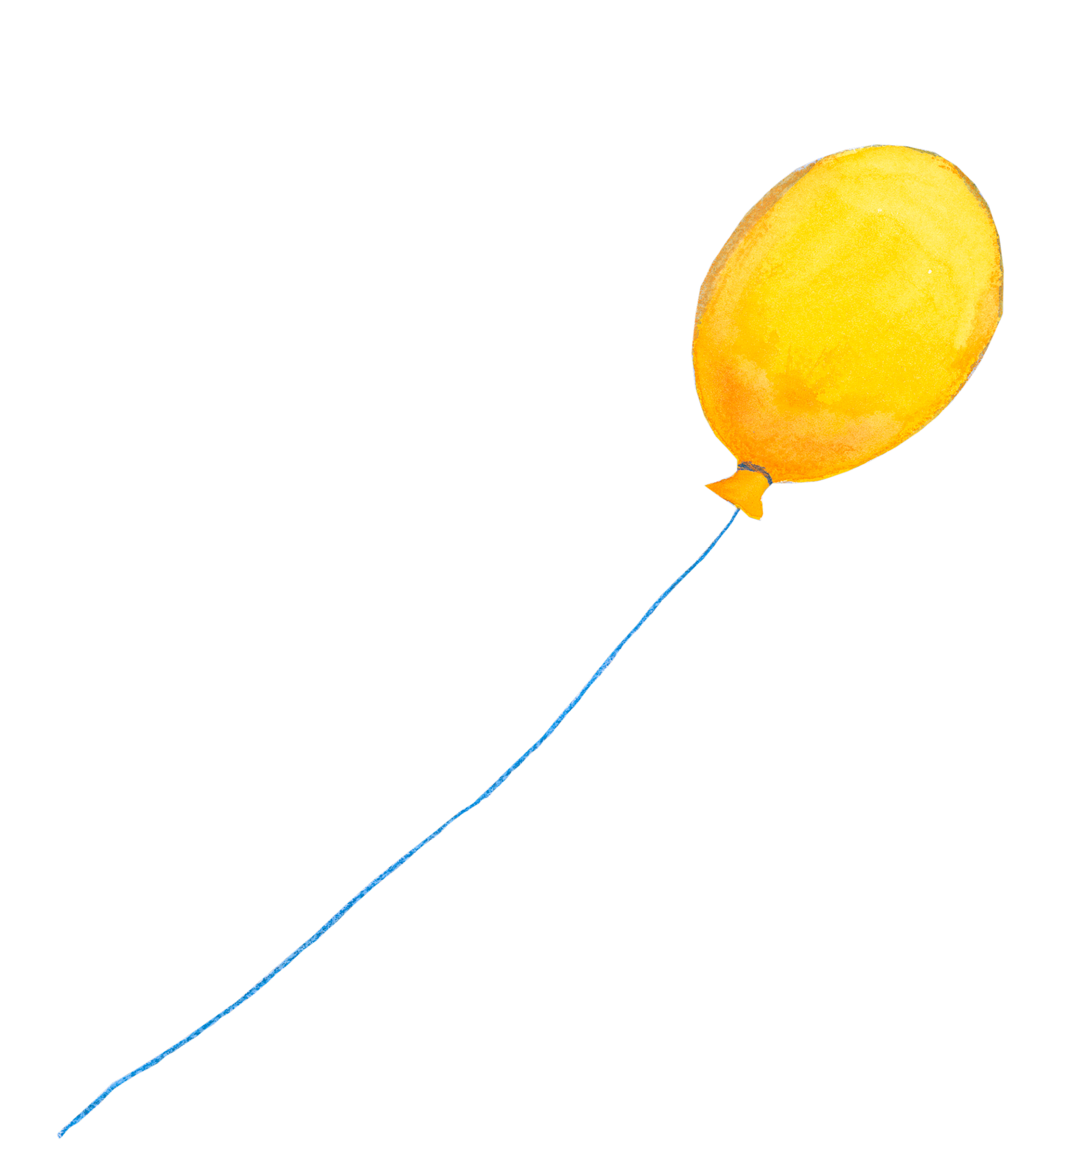
The teacher will send home a parent letter at the beginning of the year explaining “homework” routines. Each month the learning goals will change. Each week the teacher will send home different activities for parents to do to help their child meet the learning goals for that month.

Slide 4
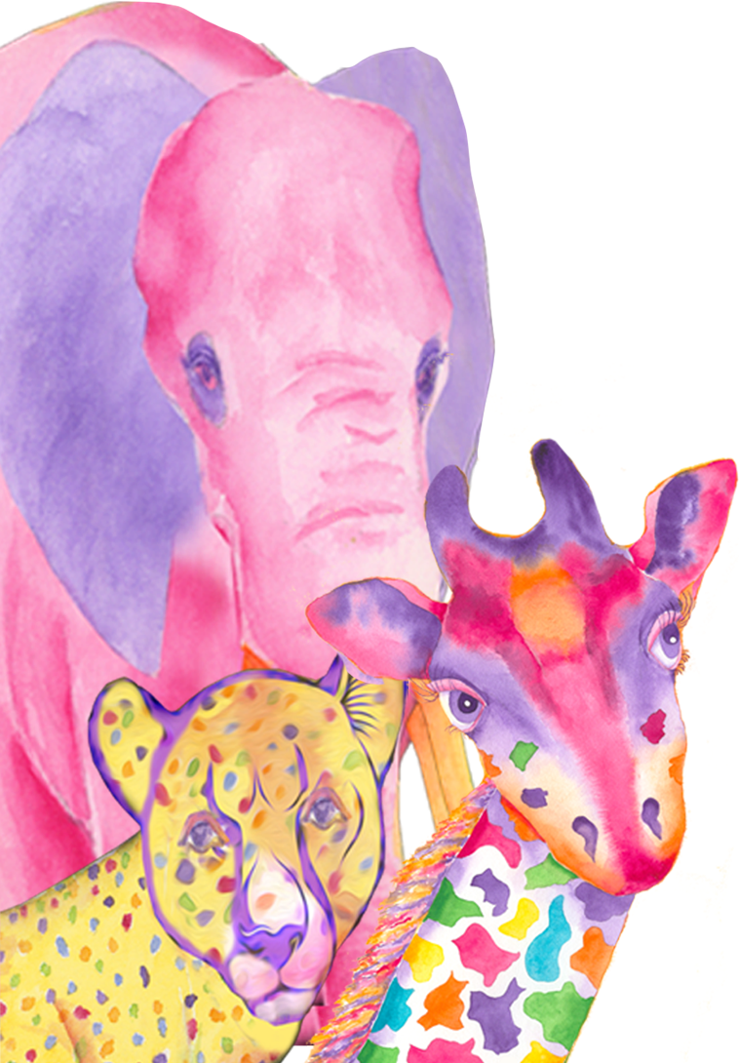
Formative assessments are ongoing and focus on improving learning through regular feedback and reflection. Research shows that students who are involved in formative assessments tend to perform better and earn higher scores than those who did not participate. Formative assessment help teachers, parents, and students manage learning by setting goals, monitoring progress, and understanding the learning process. While young children may not fully evaluate formal assessments, they can engage in age-appropriate ways that build self-awareness, accountability, and ownership of their learning. By tracking progress, teachers, students and parents can celebrate successes and address areas needing improvement.
(Messier, 2022; Paulson & Moats, 2018 ).

Slide 5
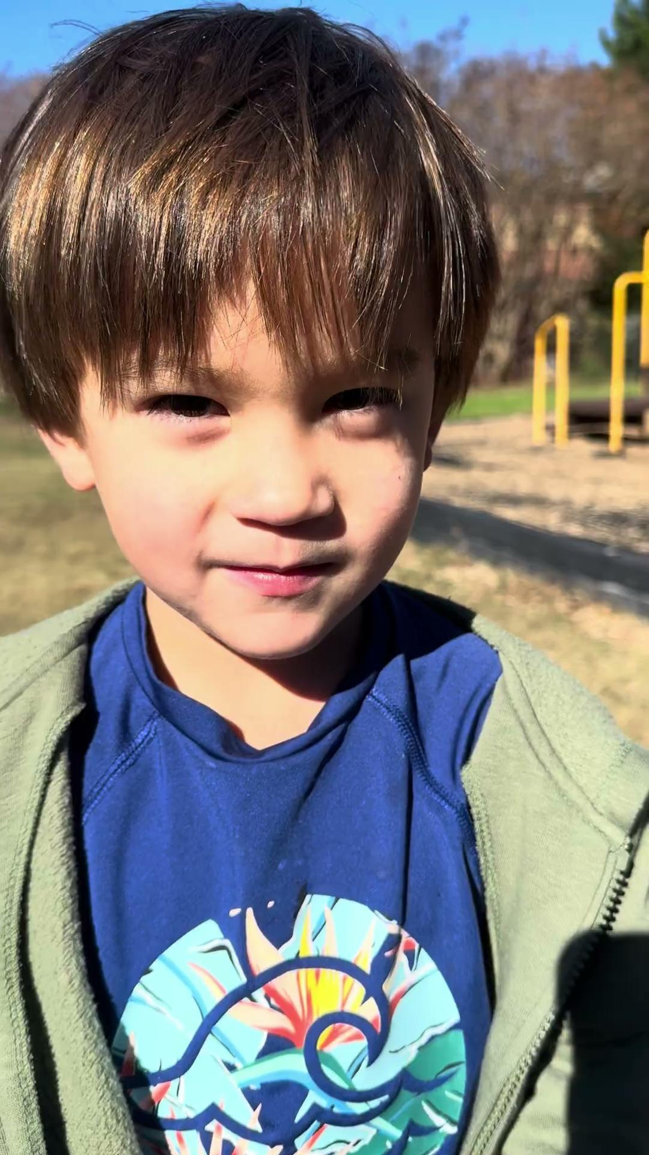
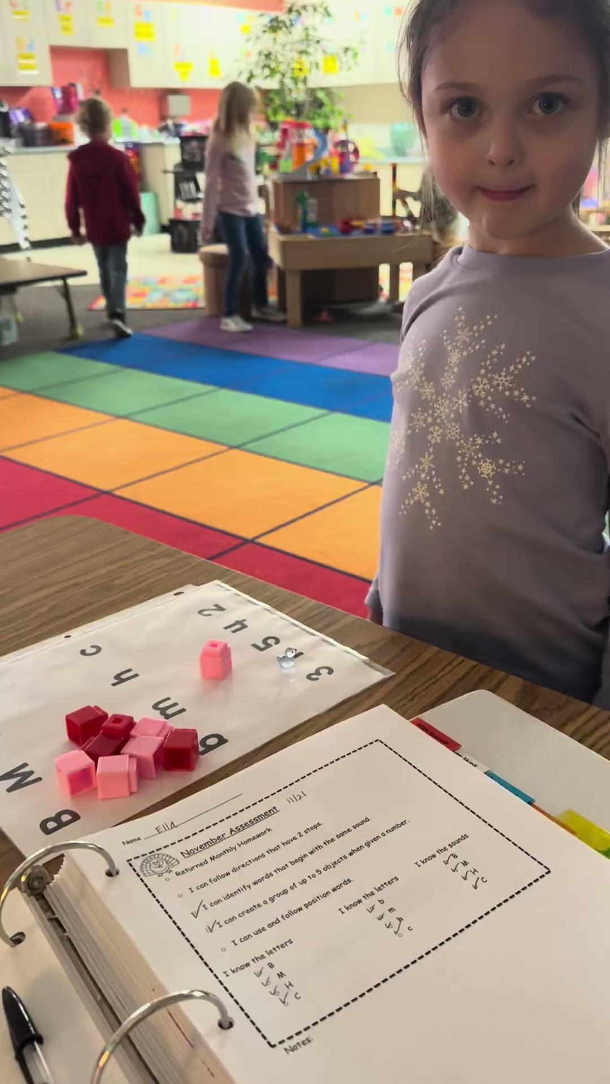

Slide 6
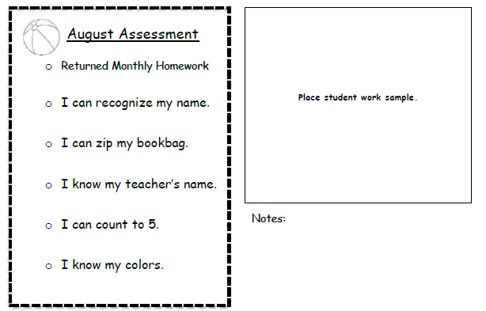
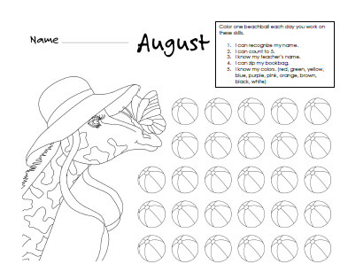
5 minute Transitions
1. Make a chart with child’s name and picture to use for line up and taking turns.
2. Put mystery object in bookbag and have children unzip to find out what’s in the bag.
3. Play “Mother May I” with teacher’s name.
4. High five a handprint on the door after they count to 5 as they walk by.
Play “I Spy” using color clues.
Parent Activities
1. Make a sign to put on your child’s door of their name.
2. Practice zipping at home. Put a jacket on a stuffed animal.
3. Ask your child to tell you their teacher’s name when talking about the day.
4. Touch each finger as you count to five.
5. Pick out a dinner menu based on colors.

Slide 7
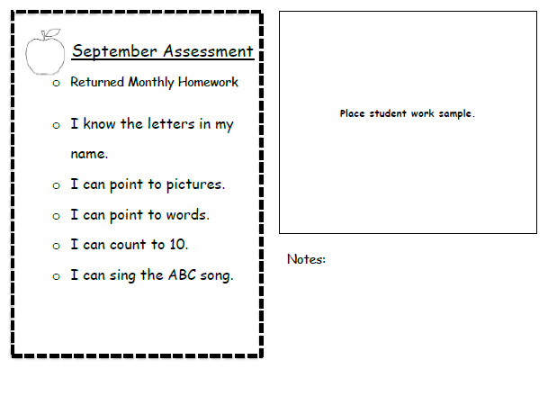
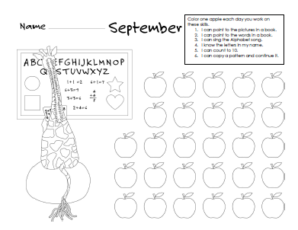
5 Minute Transitions
1. Clap and count letters in name.
2. Using big book, have student point to picture or words or put sticky note on one or the other.
3. Using magnetic letters, have students put letters on top of words.
4. Sing “One Two Buckle My Shoe”
5. Sing different Youtube versions of ABC Song.
Parent Activities
1. Make up a song spelling your child’s name.
2. As you read, ask your child to point to pictures or words.
3. Pull a page out of magazine. Cut out pictures and then words.
4. Count to 10 using different voices. (loud bear, opera, robot)
5. Practice singing ABC Song and let your child record themselves.

Slide 8
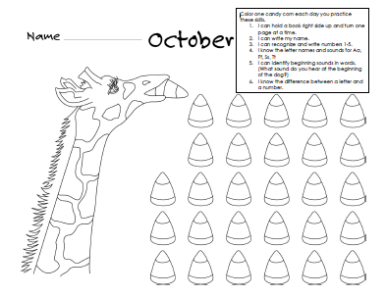
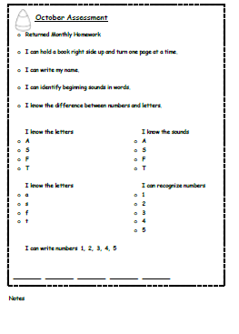
Parent Activities
1. Let your child hold book while you read.
2. Teach your child about signatures. Let them watch you write your name.
3. Help your child listen for the beginning sound of people’s name.
4. At a restaurant, show your child a menu and point out numbers and letters. Look for numbers 1-5.
5. Write numbers in dirt with stick or chalk on sidewalk.
5 minute Transitional
1. Have board books or children to look at in basket.
2. Let children practice writing their name on board in room.
3. Grab the first sound in a word and hold it in your hand. Then let it go.
4. Sort magnetic letters and numbers on board.
5. Play four corners with letters and sounds.

Slide 9
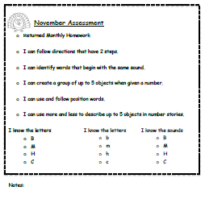
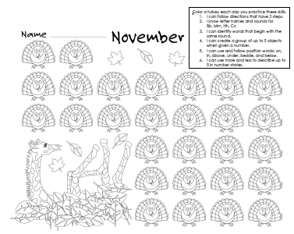
5 Minute Transitions
1. Play Simon Says with 2 directions.
2. Give students picture cards and have them go find their the picture that begins with the same sound.
3. Roll a dice and have students race to count out that many objects.
4. Give each student an object (jewel, stone, crayon) have them use position words and put it different places.
5. Have students make up number stories using objects in the classroom.
Parent Activities
1. Give your child tasks with 2 steps. (Pick up your shoes and put them in your room).
2. Give your child 3 words and have them tell you the two that begin with the same sound.
3. Give your child a number and have them gather that many. (Go get 5 spoons. Bring 4 napkins to the table.)
4. Get a stuffed animal put it above the …., under the…. Use all the position words to practice.
5. Play tic tac toe with different letters. Instead of X and O use 2 other letters.

Slide 10
For example, teachers can use assessment portfolios to help students reflect on their work. Reviewing the portfolio together allows students to discuss what they did, how they felt, and what they want to learn next. Students see assessment as part of their growth, not just a judgment of success or failure. It also supports self-regulation by teaching students to connect their actions, achievements, and goals.
(Harrison et al., 2019)
The teacher communicates formative assessment results with parents at the end of each month and asks parents their thoughts on how child is progressing towards learning goals.

Slide 11
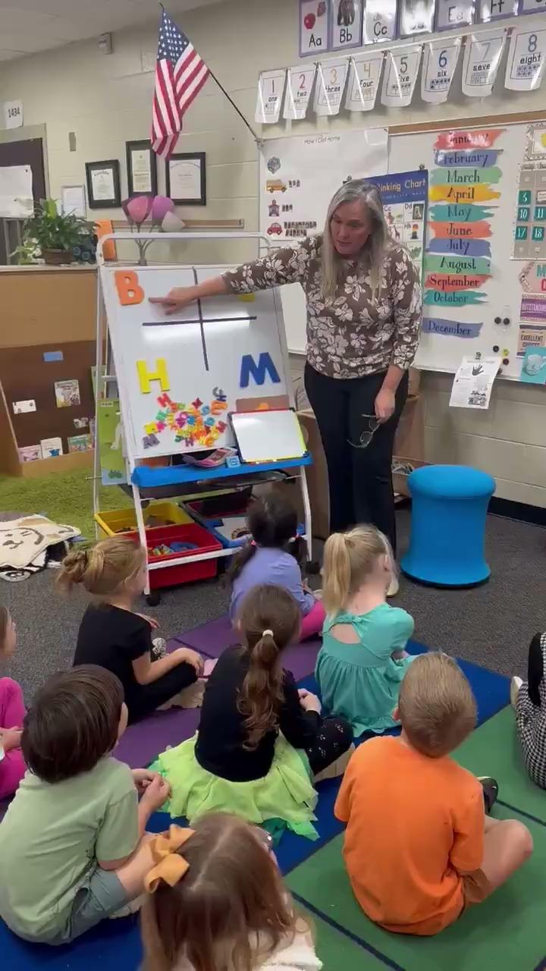
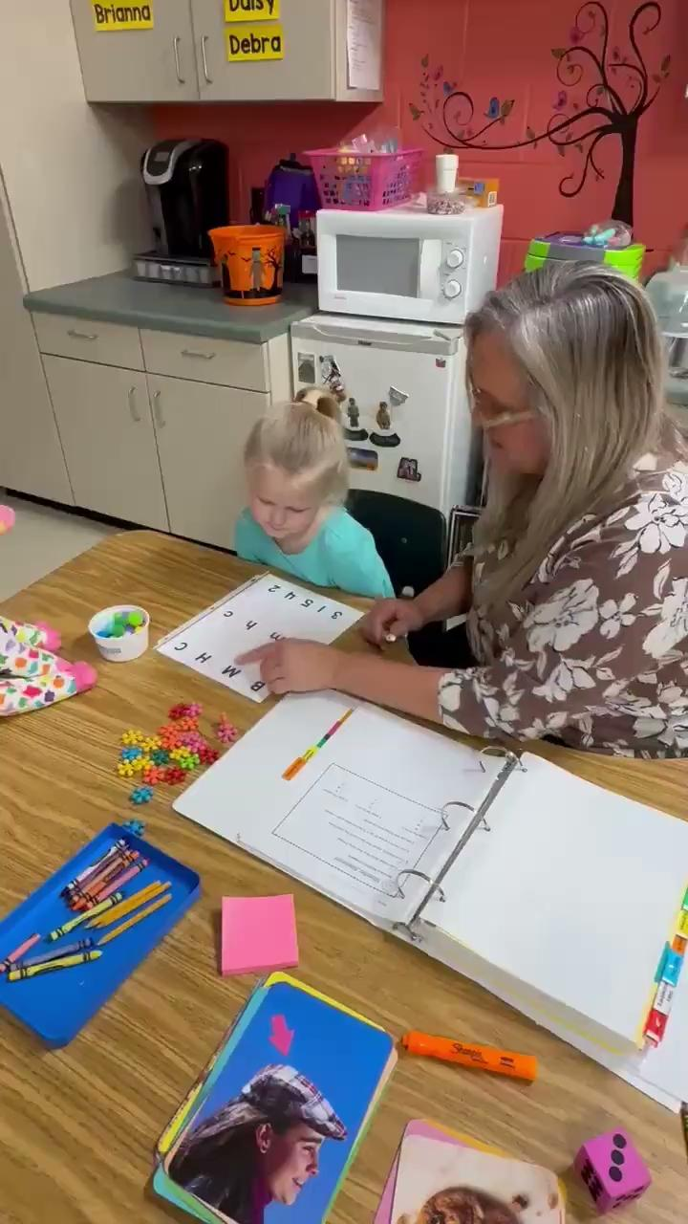
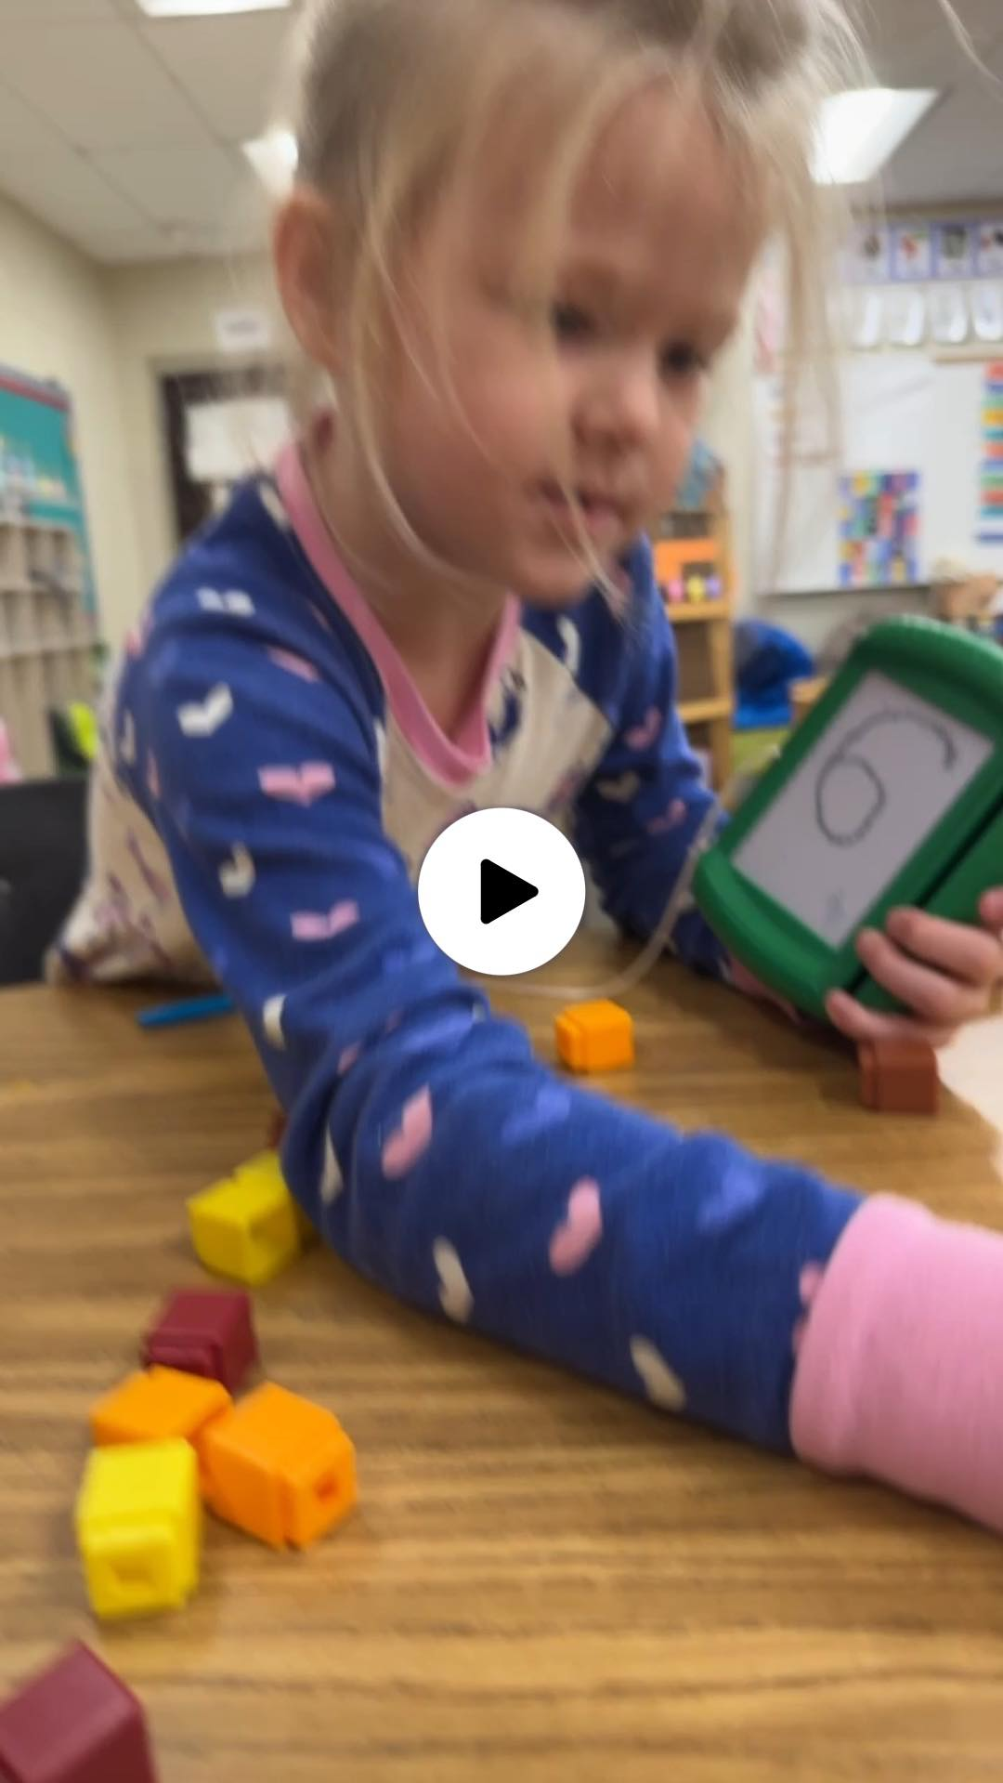

Slide 12
Moreover, formative assessment practices in early childhood help children acquire essential learning-to-learn skills by actively participating. These activities encourage children to reflect, communicate about their learning, and build skills that underpin future self-assessment abilities. This approach also reinforces a classroom culture in which assessment is an ongoing, integrated, and joyful part of the learning experience, helping young learners to feel that their efforts and contributions are valued and central to the educational process.
(Clark, 2012; Classen et al., 2020)
Learning goals are continuously assessed and documented throughout the year until they are met.

Slide 13
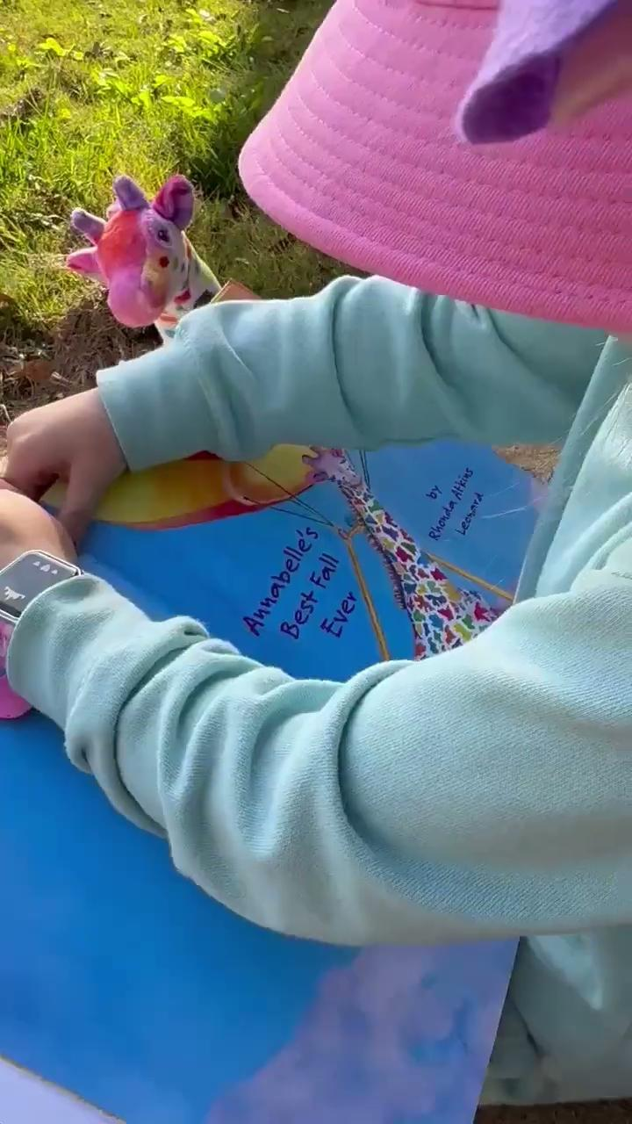
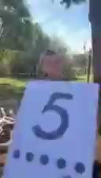
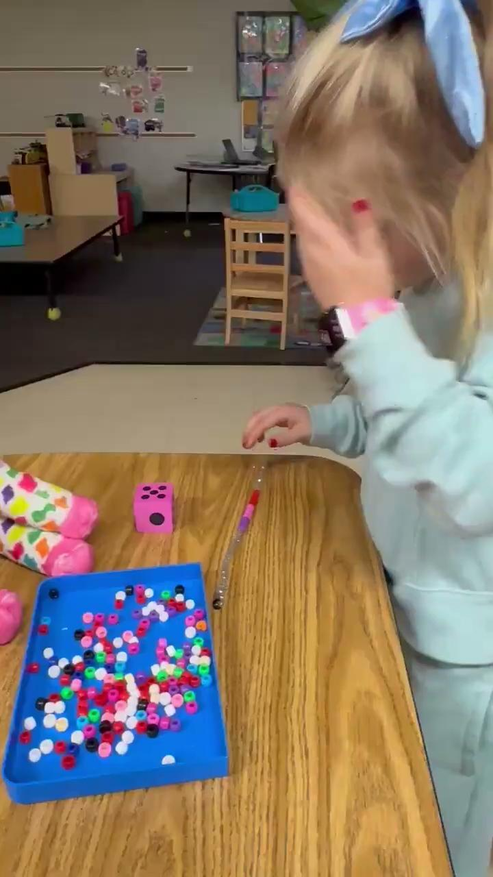
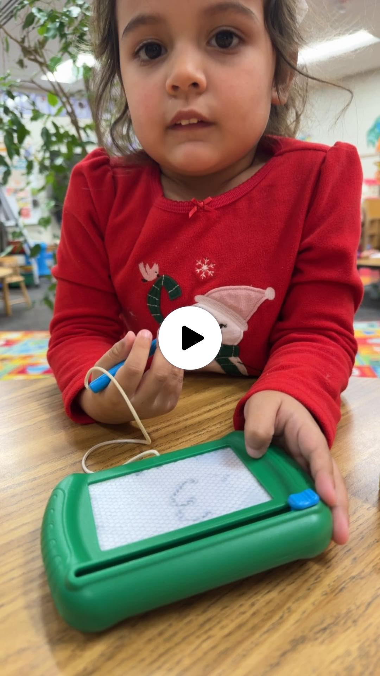
These are experiential examples of students working to meet learning goals.

Slide 14
Clark, I. (2012). Formative assessment: Assessment is for self-regulated learning. Educational Psychology Review, 24, 205–249. https://doi.org/10.1007/s10648-011-9191-6
Classen, A. I., Kang, J., & Cheatham, G. A. (2020). Current Early Educator Knowledge, Practice, and Needs Regarding Informal Assessment. HS Dialog: The Research to Practice Journal for the Early Childhood Field, 23(1). http://orcid.org/0000-0003-1196-8167
Harrison, L. J., Bull, R., Wong, S., Elwick, S., Davis, B., Kosourikhina, V., Spalding, N., Yeung, S. Cooke, M., & Luck, M. (2019). NSW preschool assessment study: Review of formative assessment practices in early childhood settings. https://researchers.mq.edu.au/files/123841104/Publisher_version.pdf
Messier, N. (2022). “Formative assessments.” Center for the Advancement of Teaching Excellence at the University of Illinois Chicago. Retrieved [today’s date] from https://teaching.uic.edu/resources/teaching-guides/assessment-grading-practices/formative-assessments/
Paulson, L. H., & Moats, L. C. (2018). LETRS for early childhood educators (2nd ed.). Sopris West Educational Services.
South Carolina Department of Education. (2024). Early learning. https://ed.sc.gov/instruction/early-learning-and-literacy/early-learning/

